Slide 1

Building & Mining Knowledge Graphs
(KEN4256)
Lab 8: Neo4J & Cypher
Pedro Hernandez

Slide 2
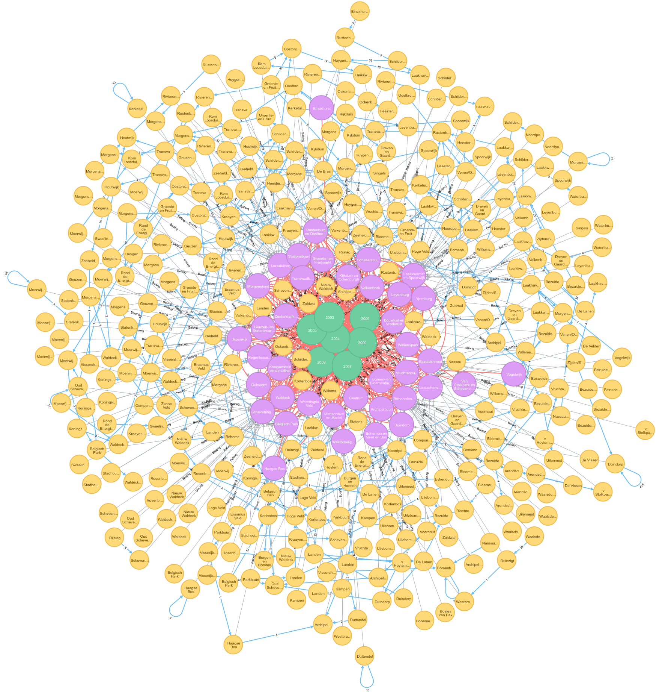
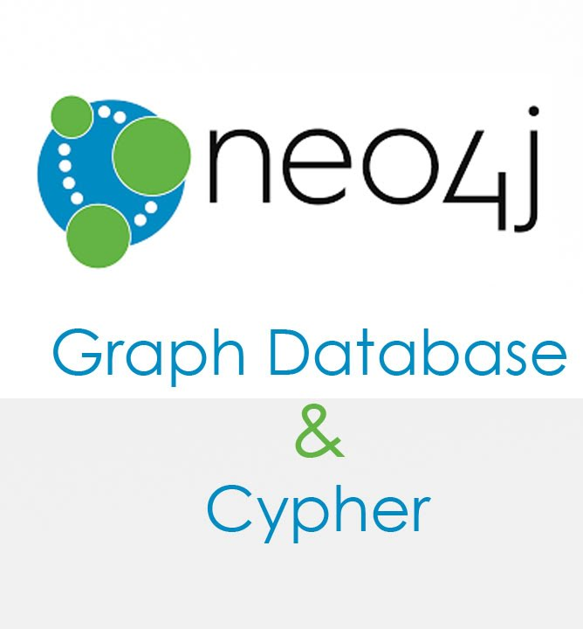
Notes:
For instance, the early adopters of graph technology reimagined their businesses around the value of data relationships. These companies have now become industry leaders: LinkedIn, Google, Facebook and PayPal.

Slide 3
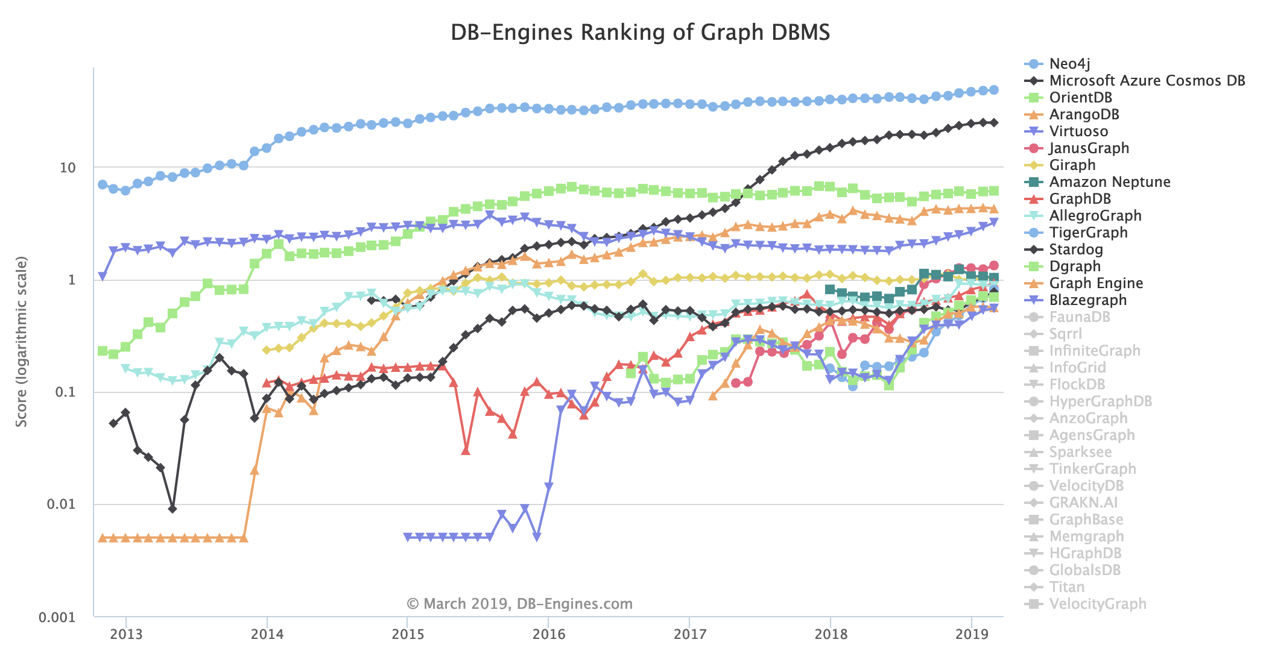
Neo4j
https://db-engines.com/en/ranking_trend/graph+dbms
Notes:
Neo4J is the first and most popular native Graph Database according to DB Engines website. It is an open source project implemented in Java and it has its own query language called Cypher. The community is quite active in Github and Stackoverflow, in addition to available blog posts and ebooks. The access to Neo4J database can be done using the Java API or using the RESTful API.

Slide 4
Labeled Property Graphs (LPG)
A labeled property graph has the following characteristics:
It contains nodes and relationships.
Nodes and relations are labeled and can store properties.
Nodes can be labeled with one or more labels.
Relationships are always named, always have a start and end node.
The graph model should be interpretable as a natural language.

Slide 5
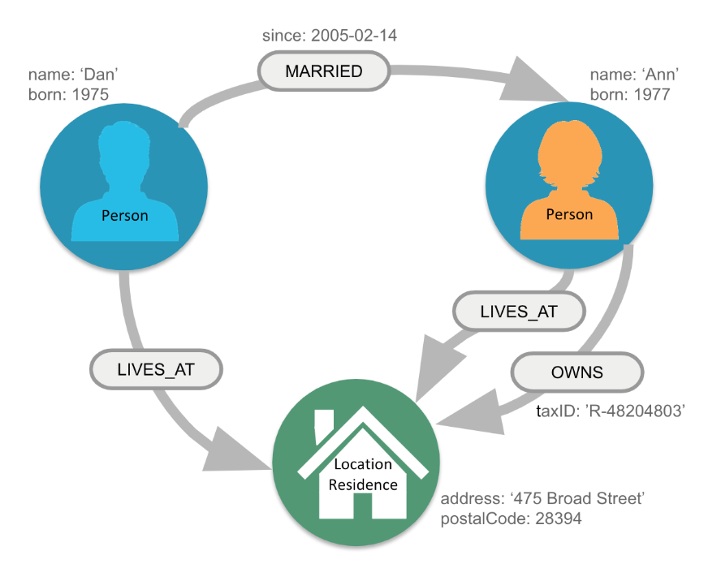
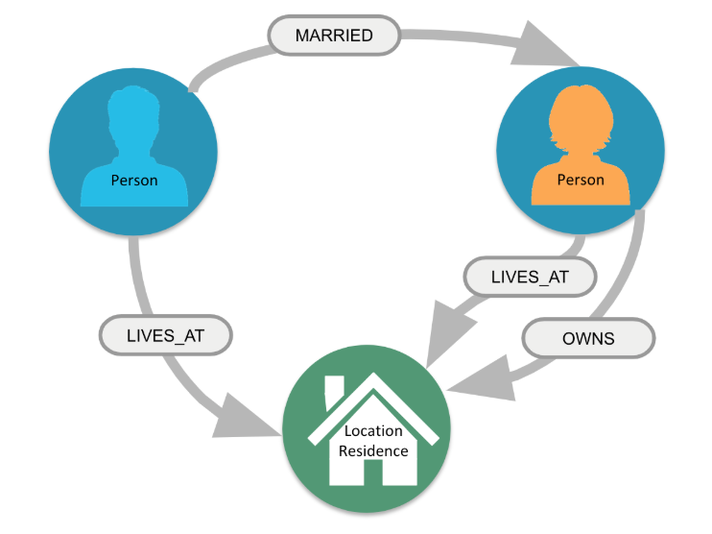
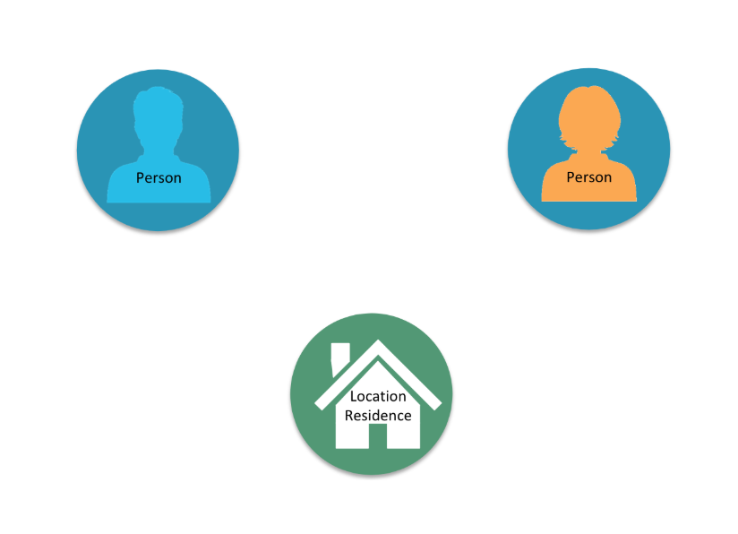
Labeled Property Graphs (LPG)
Nodes and relations are labeled and can store properties

Slide 6
Labeled Property Graphs (LPG)
The graph model should be interpretable as a natural language
Noun: Node label
Adjective: Node property
Verb: Relation label
Adverb: Relation property
Adjective
Noun
Verb
Adverb

Slide 7
Labeled Property Graphs (LPG)
Examples of relation creation.
Person named ‘Dan’ born in 1975 is MARRIED since 2005-02-14 to Person named ‘Ann’ born in 1977
Person named ‘Ann’ born in 1977 OWNS a Location Residence with postal code: 2839
Adjective
Noun
Verb
Adverb

Slide 8
Cypher Query Language
Cypher is Neo4j’s graph query language (SQL for graphs!).
Cypher is a declarative query language: it describes what you are interested in, not how it is acquired.
Cypher is meant to be very readable and expressive.
() //anonymous node (no label or variable) (p:Person) //using variable p and label Person (:Technology) //no variable, label Technology (work:Company) //using variable work and label Company

Slide 9
Cypher: Syntax
Basic representation
( ) Node
[ ] Relation
{ } Property
: Label
-> Direction
// Comment
(:Person) - [:MARRIED] -> (:Person)
Cypher
Person is MARRIED to Person
English

Slide 10
Cypher: Syntax
Representation with properties
( ) Node
[ ] Relation
{ } Property
: Label
-> Direction
// Comment
(:Person {name: ‘Dan’} )- [:MARRIED {since: 2005-02-14} ] ->(:Person {name: Ann} )
Noun
Verb
Adverb
Adjective
Person named ‘Dan’ is MARRIED since 2005-02-14 to Person named ‘Ann’

Slide 11
Cypher: Clauses
MATCH: The graph pattern to match. This is the most common way to get data from the graph.
WHERE: Adds constraints to a pattern or filters
RETURN: Return the variables stated.
LIMIT: Limits the query result.
CREATE (and DELETE): Create (and delete) nodes and relationships.
SET (and REMOVE): Set values to properties and add labels on nodes using SET and use REMOVE to remove them.
MERGE: Ensures that the supplied pattern exists in the graph, either by reusing existing nodes and relationships that match the supplied predicates, or by creating new nodes and relationships.
Notes:
Cypher is inspired by a number of different approaches and builds on established practices for expressive querying. Many of the keywords, such as WHERE and ORDER BY, are inspired by SQL. Pattern matching borrows expression approaches from SPARQL. Some of the list semantics are borrowed from languages such as Haskell and Python. Cypher’s constructs, based on English prose and neat iconography, make queries easy both to write, and to read.

Slide 12
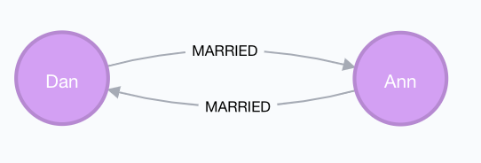
Cypher: Queries
Patterns
CREATE (dan:Person {name: "Dan"}), (ann:Person {name: "Ann"}), (dan)-[m:MARRIED]->(ann) RETURN dan, m, ann
Clauses
Variables
Notes:
Node labels
Camel case, beginning with an upper-case character
:VehicleOwner rather than :vehice_owner etc.
Relationship types
Upper case, using underscore to separate words
:OWNS_VEHICLE rather than :ownsVehicle etc

Slide 13
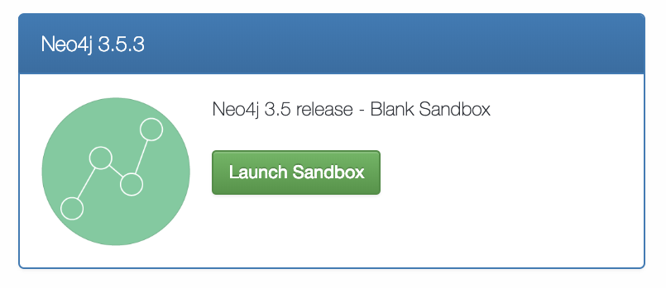
Go to:
neo4j.com/sandbox-v2

Slide 14
Creating nodes with properties
CREATE (:Person {name: "Pedro"})
CREATE (:Person {name: "Kody",
department: "IDS",
hobby: "Cricket"})

Slide 15
Creating nodes, a relation and return them
CREATE (r:Person {name: "Remzi", position: "Postdoc"}),
(a:Person {name: "Amrapali", department: "IDS"}),
(r) - [:KNOWS] -> (a)
RETURN r, a

Slide 16
Updating relations and properties of existing nodes
MATCH (p:Person {name:"Pedro"}), (k:Person{name: "Kody"}) MERGE (p)-[:KNOWS]->(k) RETURN p, k
MATCH (n {name: "Pedro" }) SET n.department = "IDS" SET n.hobby = "Cooking" RETURN n

Slide 17
Retrieving nodes and paths
MATCH (node:Person) -- () WHERE node.department = "IDS" RETURN node
MATCH path = ( ) - [:KNOWS] -> ( )
RETURN path

Slide 18
Creating relations with different type of nodes
CREATE (:Course {title: "Graphs"}) MATCH (c:Course), (p:Person) WHERE p.name IN ["Remzi", "Kody", "Amrapali"] CREATE (p)-[:TEACH]->(c)
Click on TEACH relation

Slide 19
Creating a full path
CREATE path = (:Person { name:"Michel" })-[:TEACH]->
(:Course {title: "FAIR"})<-[:TEACH]-(:Person { name: "Ricardo" })
RETURN path

Slide 20
Metagraph and features
CALL db.schema()
Get all (*)
Color and size of nodes and relations
Export options, image and table
MATCH (n) DETACH DELETE n

Slide 21
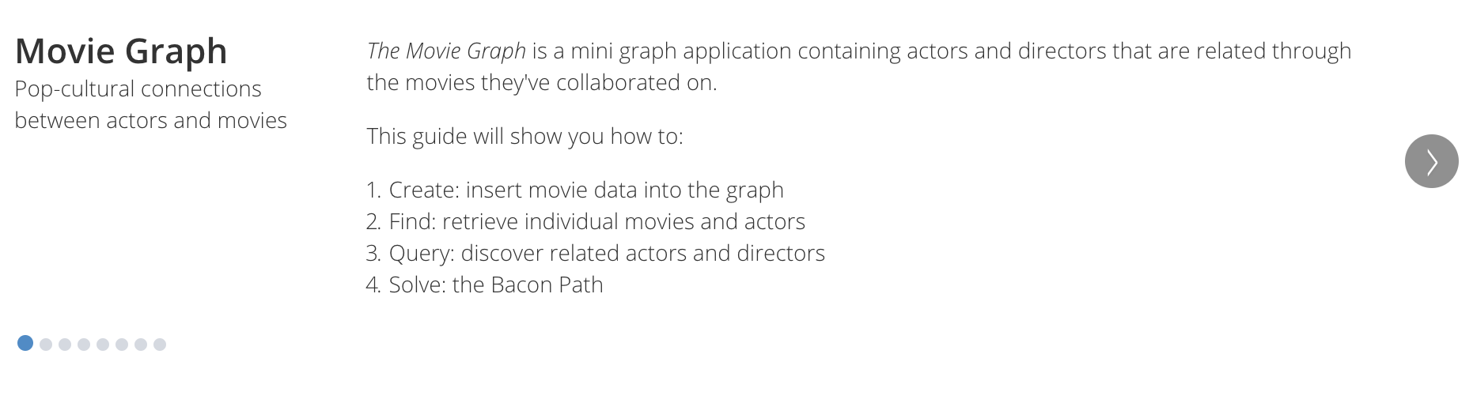
Let’s explore the movie graph
:play movie-graph
Write command
Click

Slide 22
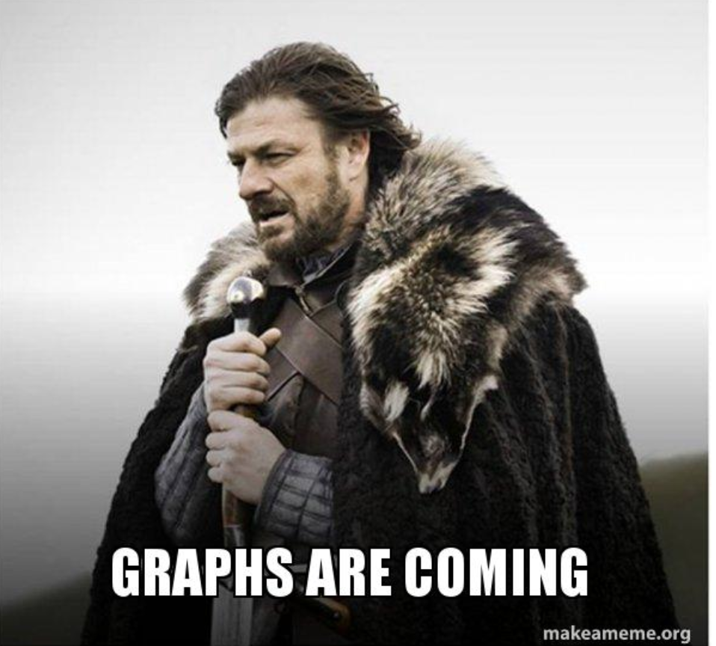
You have created your first Labeled Property Graph!

